Slide 1


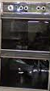

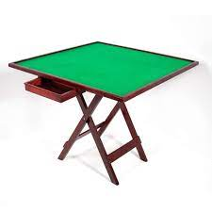

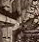
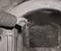
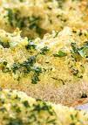
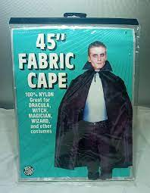
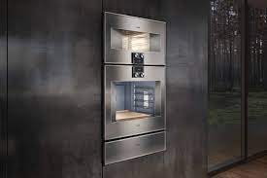
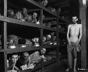
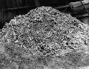
FBI
partner
development
outsdiee
Marlin Blvd
Washing machine in room, depshoe house wife
INTERNET
Webster Str
!the.game
Webster
Quartz Circle
000.marx
x
no
?
CIVIL CODE
IMPORT
Auscwitz
[x] no

Slide 2
FBI
partner
development
outsdiee

Slide 3
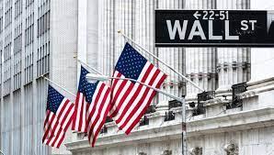
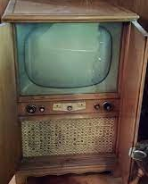
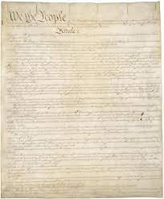

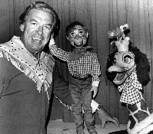
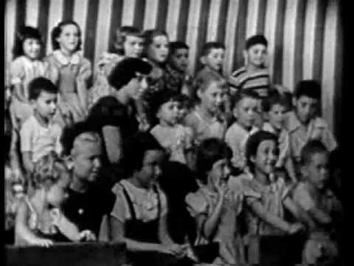
FBI
partner
development
outsdiee
Water
N. Braciforte
Chart
nonPoliceTRX
Hoody Doody Audience
Edwin Johnson Television Set
Free
Marlin Ave
Edwin Johnson Television Set
Philip Phonson

Slide 4

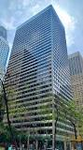

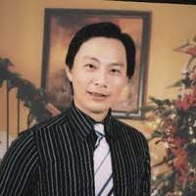
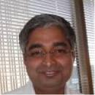
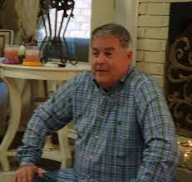
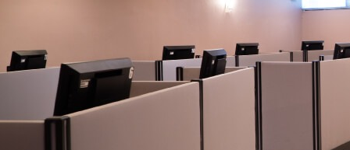
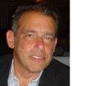
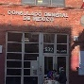

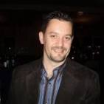
FBI
partner
development
outsdiee
13th VIRGINA italien floor
Ibm.client.*.nonPOliceTRX.diagnotics
J2EE.IBM.WEBSPHERE
9%
Raise
San Francisco, 435 Market
SALES: IBM Siebel Database (HQ San Mateo, California)
Austin III
Raise
Bank of America ( Foster City, San Mateo, California)
Siebel Systems San Mateo, California
z/OS !raik ONSITE Foster City, near mall (Sony Bulding)
2005 FEDERAL.DEFAULT.MEXICO
IBM Consultant with suite 2-year contract, combed hair
EXPORT Moped in India
I had a moped in India as a teenager
SALES: IBM Siebel Database (HQ San Mateo, California)
Raise
Siebel Systems
Client visa; bina have yellow? Nuts?
Tivoli Agent
2005
FOSTER CITY, CA
$1M
Siebel Systems San Mateo, California
$30,000
FOSTER CITY, CA
FOSTER CITY, CA
docs
2014
docs
Tivoli Agent
MARK(SALES)
FOSTER CITY, CA
$1M
Bank of America, San Mateo, California
$30,000
Raise
Other:
2007
MLK
Raise
FOSTER CITY, CA
$1M
Raise 10% Overall
3% $65,000 ~$2,500/y – tax= rent+2000

Slide 5
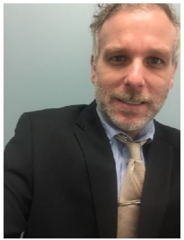

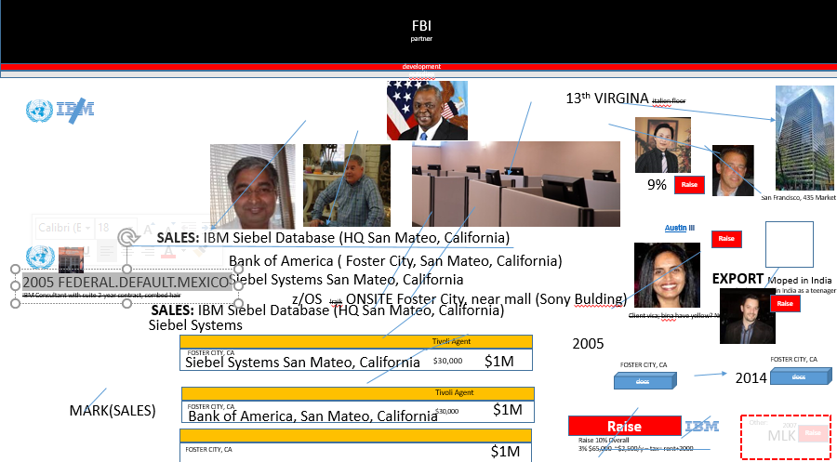
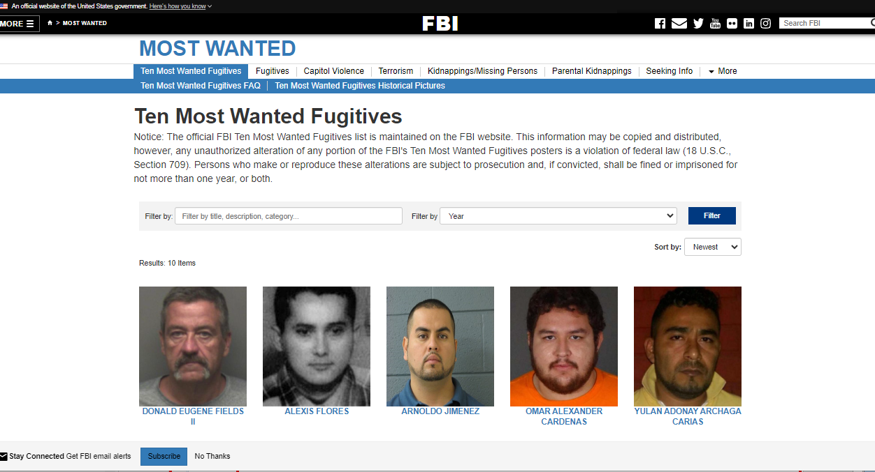
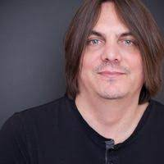
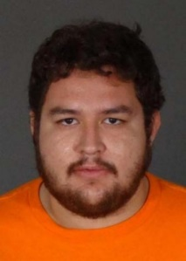

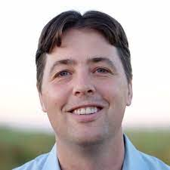
FBI
partner
development
outsdiee
Accomplished Startup with Acquistion to IBM
CPVA.§187.PREA
CPVA.CIVIL CODE LABOR CODE§422.6 HATE CRIME
IBM SWAT (400,000 People)
- W/SAM SWAT (40 People)
- Cyanea SWAR (30 People)
CPVA: nothing to do with these people, CPVA placements
TERMANTOR:JOESPHE:CHAN
SWAT TEAM
>30 people, Medication and Behavior
dominique glu
…
…
I will put you directly on the screen, piece of garbage
TORT-2 CIVIL CODE:§Elder Abuse
Jung(trnal)young: 20
Tango
Ivan Ivancvhic
Tango
Micheal grazianni
>30people

Slide 6

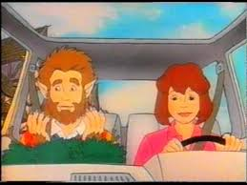
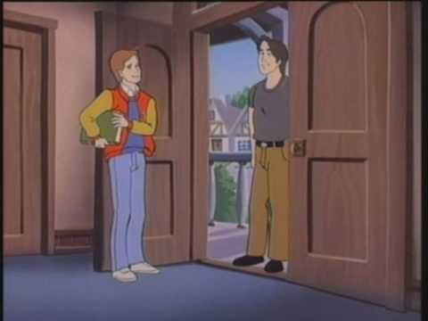


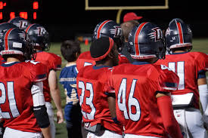
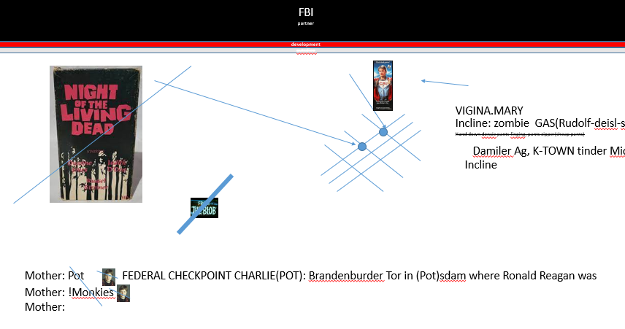
FBI
partner
development
outsdiee
“Boyfreind”
Dublin California High School
CPVA.2018.nonPoliceLanague(HOMCE:PETER”boyfreind)”)
WW2.CPVA.CIVIL CODE.nonPoceLangue(“boyfreind”)

Slide 7
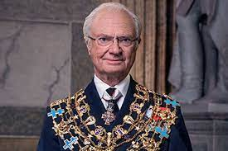
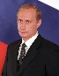
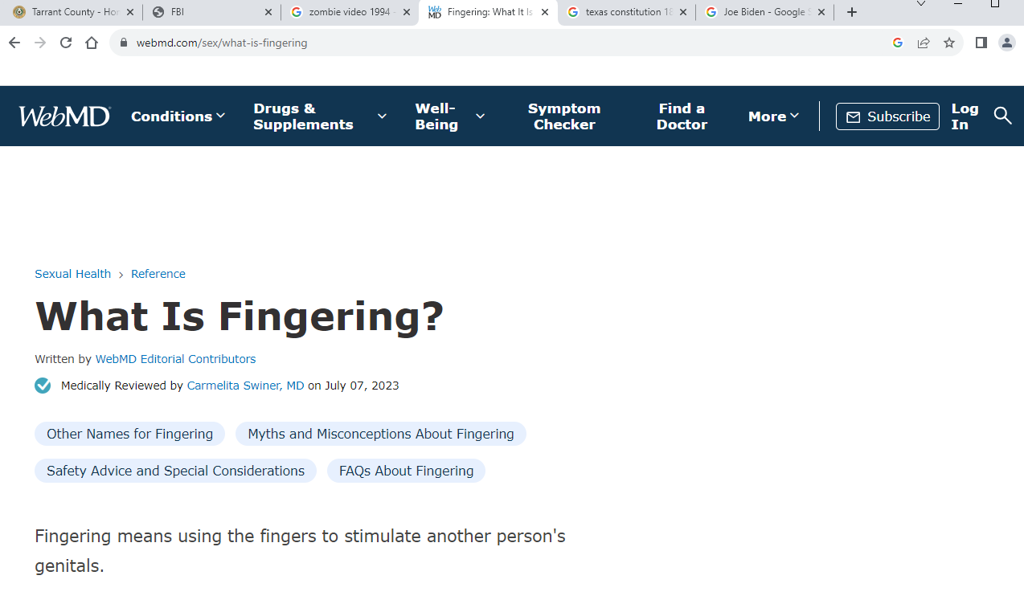

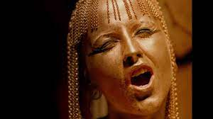
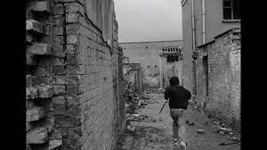
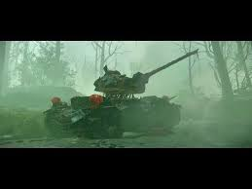
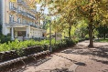
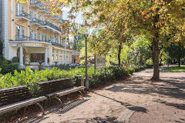

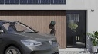
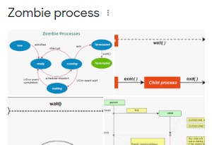
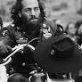
FBI
partner
development
outsdiee
1995
PENTAGON.VRINGA.MARY
41.0.125
2023
x
x/y
V2.FBI:KIDNAPPIGN
Soviet prison
HOMICDIE:ur_ur_opi
!BRAVO
ALPHA
TANGO
01. pms:recyeling
x
CPVA
HEIDELBERG
!AVABILITY
In
Unix zombie
BASE
HOMICIE:PET[bunny,cat,dog,…]
zombie
Petting, heaving petting,
!heaving petting, rap.*tophat
St. Rita.Petra.Mark
HOMICIDE:NANA
0.1 ATB
Assuemd: murder ATB incline; they will murder the germn if US nana is not mured in (CLUE) Baden Baden, ask the murderer.
[x] no
WAR
Unix zombie
Kriegstrasse
UNIX
WWI.INT
I will have sex and get job amarreid.
? Figernign?
Backup: petting, and heaing peeting
nonPoclieCfg.nonPoliceMpa
[x] no
41 hells angels.apple
Auschiwth:gas
WWI.KTOWN
1
Candle in wind
Ddr spy angels elebteh, garden company no atom bombs
Elesabeth
Bealtes

Slide 8
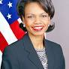

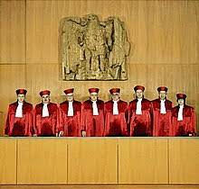
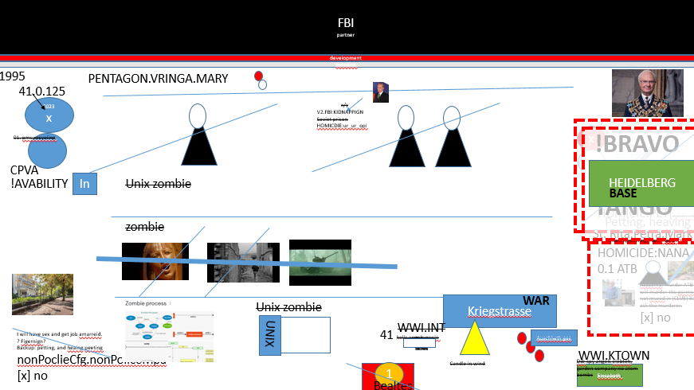
FBI
partner
development
outsdiee
IMPORT CPVA.2014 break-point cisco montorng Yougurt out of Sams Asss
FEDERAL GERMAN CONSUTTON AL COURRT
IMPORT G.God.Titant.Ataltic Hotel
IMPORT G.God.ibm.client.moodies
Leave this women alone

Slide 9
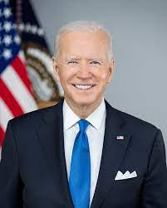

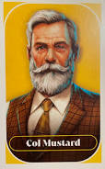
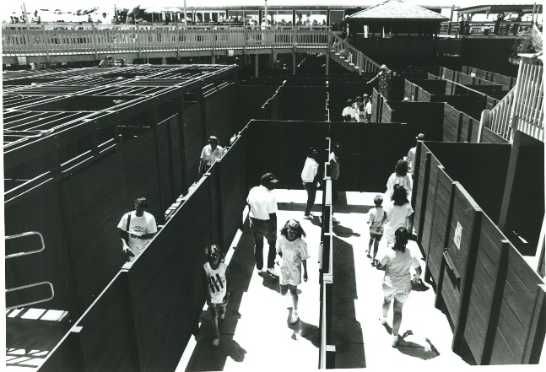
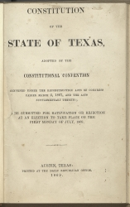




FBI
partner
development
outsdiee
Mustard
Verdun, WWI GER/FRA
HOMICDI:NANA elebeth 13th Grade
I am playing clue, cournel mustgar I don really care
0.1 1988 Mustgar Filed Davis, Mother-Joe Cogtinve.attement 2010 Mother-Joe
WWI mustarg gas
Wooz, Tyson, Davis, Woodside
MARK(ibm aruns boss):HOMICIDE:NANA
Tivoli, Austin
stamps
1986/7
American Civil War
Apr 12, 1861 – Apr 9, 1865
1869
1988
80
SAC
x

Slide 10











FBI
partner
development
outsdiee
1986/7
notes
1985
1985
41.WW2.Blond Shaming.CIVIL CODE
x
VP GERMANAY.DEA(mdma)
§Adulti Parage Fornication Caliifniacatoin
x
I you buy this doll then I will not play with you.
1987 Saturday Morning Cartoons
silent: “I am glad I am white”
Give me my cookies.
Nintendo
wt.dev-eng.avg
x

Slide 11








FBI
partner
development
outsdiee
Entry
0.1 asuem: KING fucking this guy in asshole the whole time
Since 1983
Tim cook since 2010 HOCI:ITALEIN
§Human Traffing.children.§SexAbuse
v2.FBI:KIDNANPG:CPVA 0.1 rt HOMICDE:PETER asusem: KING fuking this guy in the asshoel the whoe time
docs
Hello is Jenny There?
Yes
Can I come in and play with her?
Exit
SALES: 2014 CPVA
41. I don’t even know if this person name is jenny
WW2
ATOMCLOICK(Gheoh(michala).friend) is named jenny
Phil(kim).RED TRUCK.husband.
SALES
1984
2014
PREA.START 2014->2022 “aka. Anal Sex Prison Assfucks”
Ibm.damiler.apple.*
Since HOMICE:JSOER(steve jbos).2010 HOIMCE:ITAILEN:20
IPX.tim cook/dr dre PREA.friction

Slide 12





FBI
partner
development
outsdiee
Anachy I
§Human Traffing.children.§SexAbuse
V2.FBI:KIDANNPG docs
docs
Anachy 2
And they put the fault on assshole
V2.FBI:KIDANNPG docs
HOMCEI:PETER assclener
0.1 usher, ss, Africa, asscleaner program-brain

Slide 13












FBI
partner
development
outsdiee
Mopay Wife Google Firstarter
Google Jana Front Door
Klu Klux Klan Flag
->2022 tom cruse not firstarter
Entry
JFK( ddr spy jana, jacklin)
no
Hello is Jenny There?
I brogh this doll, she did not want me to buy it
And have my police id
Yes
Can I come in and play with her?

Slide 14




















FBI
partner
development
notes
41
She as in there
Every time I walk out the fucking door Cupertion chinease fuck and kkll furuck, $800,000 pergola at the front door, klu klux klan flag SIN at work
SIN at work klu klx klan flag. CPVA Antonnoete. IN-AND-OUT
Piect of shit
V2.FBI:KIDNAPPING
2014 Police sirence:11:33am
yes
G.fire.vw.traders.joes.intel.father
x
WW2,WW1.grave
x
1994 CAR-BENZ-SATR
JP MORGAN
chevy chase kkk movie porche freind of yours
Visa soccer Brama obmaa
Call jordon
Annoten, ron did not want the plastic ne from home depot. Nor fir sticks.
IMPORT !In
Where is my white picket fence
Philip bouth an appamretn righ beroffe 2008 for $300,000
Pin: picked fuin
Police sirence:11:33am

Slide 15




FBI
partner
nonPoliceRTALogial
development
41
Hello Nina, Idnian whore, you are a black whore from india(name winer and musish) because fo thekl-luc clan,
How are you?
I am find can you bounce the server?
He is member of the klu fklu clan
no
I can see that exaclty
Yes
There is fuuking kkl flag in fron of his door
Eval.calc

Slide 16




FBI
partner
development
outsdiee
notes
i.e
notes
sw(de)-sw(us).marx
HOMICDI:LUX:Waldorf:(Forrest village)
Sap Walforf
G.God.marx.v2:FBI:KDAINN.CPVA.nonPoliceSexAbuse
i.e
Die judenfrage; (tranl) the jewish question
HOMICE:HANNES
41
[x] no
¼.marx.murderer
nachtcafe tv schauspieler walldorfschule
Change content boy intete with nache guy
HOMICE:HANNES

Slide 17


FBI
partner
development
41
[x] o

Slide 18


FBI
partner
development
41

Slide 19


FBI
partner
Manisha
development
41
Ghandi San Francico
!IN
You want o be ghandi
41.G.God.HOICM:MAYOR: mtoerh Teresa
Sayah trucks:She threw out the pople in govment,mtoherterest
Inclines in the fire
41
41

Slide 20
FBI
partner
development
“You cannot and may touch this”
My head. Ibm-dns:touchurban.com

Slide 21












FBI
partner
development
outsdiee
1994
Otto-Hahn-Str
KING
VIRIGNA.MARY
Military
Deere Park Ave
notes
notes
John A. Lederer
notes
Staples
Touch
notes
w/o easy button Hendrik abraham
Ph as in Phd
ph
INT.DR.G.GOD.JESUS.shipping
v2.FBI:KIDNAPPING
Marlin Blvd
1986/7 foster city kindergarden student touching soccer jersey number
free
7
notes
x
Manual
IPX.INT
2000/1 HOMICIDE:NANA
Kriegstrasse
Nirvana;long hair blond(medium tall)
PAYMENTS vpn client, mouse:x,y
x/y CPVA.PENTAGON.ATOMBOMB visa.mouse.wfh.x/y.mccarhty
Elisabeth

Slide 22






























FBI
partner
development
§Treason FEDERAL BANK PAYMENTS GREENSPAN
jim morrison movie fight with wife
Apple.greenstamps.schoolshooter
notes
notes
CPVA Principals Office
Ryan McInerney
PAYMENTS
Hengels, Jason
Jogging gheoh(Visa Frace)
You did not speraton smith and Huy Pham for king/queen/jobs/jobs/meiers/meiers/meiers/meiers/sme;r
And CPVA.!ABABILITY.NOC.PHAM?
IPX 1998 HOICME:LUX 1994; 2005 ibm-dns:maincoon.de(older married couple 220lbs each mustache )
P-i-z-z-a G.God.St Franci.Angela.Vp Germany.Grazzi.(dela donna).freind !WAR
Friedenstr
Pizza(oven)->Auschwitz (train) {stop}
Penrogn Deere Jefff Jahnke(drunk) on train
notes
notes
IMPORT !WAR
hr.kim.phil
INTERNET PAYMENTS Separation Smith
TORT-3
§123 Hausfrienesbruch
§Sexual Assault
PAYMENTS
jim morrison as peeping tom
V2.FBI:KIDNAPPING visa.hr
Face
notes
SQ.CDCR.FBI.INESTIN(cahles mson, thoas-is-dierte:wyland).gorbachev(micheala, skin)
PG-17+
?,Texas
CERTIFIED
facials
Face
Andy Moore
IBM Prolifics
“The buchter”
SQ.CDCR.FBI.INESTION(cahles mson, thoas-is-dierte:wyland).gorbachev(micheala, skin)
facials
notes

Slide 23





FBI
partner
development
outsdiee
Age 6
Age 28
Age 31
x
x/y
Joe/joe/!joe

Slide 24












FBI
partner
development
outsdiee
Age 4
Mainstreet
1984 March 23rd
Elementary
School
Age 5
8 December 2021,
Age 5
1984 April
Swimming
Certificate
camping
“The Game”
Sap.ATOMBOMB(hahn).twins.IPX.INT
Gorbachev(Karl Marx)
fleah
starware 5 boy labor
[x] no
0.001 §Sexual Aggravated Assault Appeal to Daughter for further conversation in 2033
[x] no

Slide 25






FBI
partner
development
outsdiee
JFK(MATHEW(CVPA)): heilos-kayoulou
notes
HOMICIDE:AUSLAENDER
Phil(kim).GovSchw.marx(twins)
OFFSITE
notes
43Y
ONSITE
Business Process Management 1776
Zanzibar
1809-1776
https://www.worldstatesmen.org/Zanzibar-constitution-1963.pdf
senegambia
33Y
The ILO has a unique history within the UN framework.

Slide 26




FBI
partner
development
outsdiee
CHECKPOINT CHALRIE(store clerk)
Romance
thresome
“Adam” 9-1-1

Slide 27










FBI
partner
development
outsdiee
0.1 §Sexual Assalet jolly roger is a …
to suck my jolly
jolly rogher is my penis
0.1 §Sexual Assalet jolly roger is a …
to suck my jolly
jolly rogher is my penis
notes
1983
notes
Age 3
x

Slide 28










FBI
partner
development
outsdiee
HOMICDIE:NANA
MATHEW(CIA:LANGLEY)
2005 petersson
1990
Hudson Court
notes
HOMICDIE:NANA.§Sex Asssulte BPM “!romance”
CHECKPOINT CHALRIE
HOMICDIE:LUX:VHS “romance”
IPX once upon a time in america
§ 201a Stobering
romance
KING(IPX Backerfield/Horden-Karlrueh).CPVA.US-PREISENT.cisoci.motnr.sam
Message from SAM
Gheoh(meiha,friend; person lives in back sommer)
PENTAGON VIRIGN MARY.CHERRTTREE
Sound on Penthouse

Slide 29

























FBI
partner
development
outsdiee
1989
LEVEL: v2.FBI:KIDNAPPING
0.1 INFIDA ATOMBOMO(SQ.ELECTRICCHAIR(curlfries)SF
CHECKPOINT CHARLIE(HOMICIDE:LUX:VHS)
HOMCI:IS-A-BELL(soviet union, SQ.AIRFIEL.COLEMAN.MATERIALS(tape:casset:video IPX WAR(midi))
CPVA.putin.!PAUL
1990 CHECKPOIN CHALRI(§Child Traffking)
IPX CONSTITUION<<COPY>>
IPX HOCE:LUX:VHS<<COPY>> pxl camera
notesLE
Emea.basf.deere
PAUL
CHECKPOINT CHARLIE(HOMICIDE:LUX)
notes
PX MILITARY werkaufs!walmart
Doug McMillon
IMPORT CPVA toysrus.int
notes
Siemens
notes
moving
Auschwitz
Daimler Truck North America President & CEO, John O'Leary
Quartz Circle
notes
notes
ATOMCLOCK
Last TV and Computer before leaving 2015

Slide 30



FBI
partner
development
outsdiee
1989
ATOMCLOIC(FBI:WMD for ATOMBOMB)
Gheoh(mciha).dead
!TALK

Slide 31





FBI
partner
development
outsdiee
1989

Slide 32









FBI
partner
development
outsdiee
5¢
C5
j5
VIGINA.MARY
Incline: zombie GAS(Rudolf-deisl-strast)
Hand down densie pants finging, pants zipper(cheap pants)
j5
c5
Damiler Ag, K-TOWN tinder Michea J Fox(as you look)
Incline
Ibm(o;sadreo))damiler.Apple.tango.tinder.leatherjack tiberoun
HOMCIE:NANA 1986 HOMCIE:LUX:gestapo
“The Question”
FRANLIN:HOMCE:LUX(Benjamin)
41.Prestations/Actiong (Lessons)
Screen: What is fingering?
Steve Meiers Sharks – IBM PARNTER LCIENT WEST MARIN
FRANKLIN
CPVA Gestapo.nazi.!living
SREVPORT POLCIE COURT
LOUSIANA
CASH REGISTER
The will com back gehy are famous, dead
Mother: Pot
FEDERAL CHECKPOINT CHARLIE(POT): Brandenburder Tor in (Pot)sdam where Ronald Reagan was
Mother: !Monkies
Mother:
41
Jason: Hamiltion(de).avg.angst(us)
J5 zombie/black J5 zombie
1986/7 J5 !white ATB.avg.TV
Mother:
Mother:
The Dead greatufl dead
Phil(kim).gheoh(Dell.hitchhiker)
0.001 Are the greatful because they are dead?
Mother: do you like that girl
I would assum you like a girl
!Free.monkie(beatles).atari.apple

Slide 33




FBI
partner
development
outsdiee
1989
SCREEN
nonPoliceRta(Cypress:Robotics)

